Slide 1
How to Add a Book The Elements of Style by William Strunk Jr. to Amazon Shopping Cart

Slide 2
Contents
Contents of this guide are listed below:
Login to Amazon.in
Search for The Elements of Style by William Strunk Jr. Book and Apply Filter
Add The Elements of Style by William Strunk Jr. Book to Amazon Shopping Cart

Slide 3
Purpose
This guide explains how to locate the latest publication of The Elements of Style by William Strunk Jr. on Amazon.in and add it to your Shopping Cart.
Audience
Any end user who is comfortable using a computer and surfing the Internet
Prerequisites
Sign in credentials of Amazon.in

Slide 4
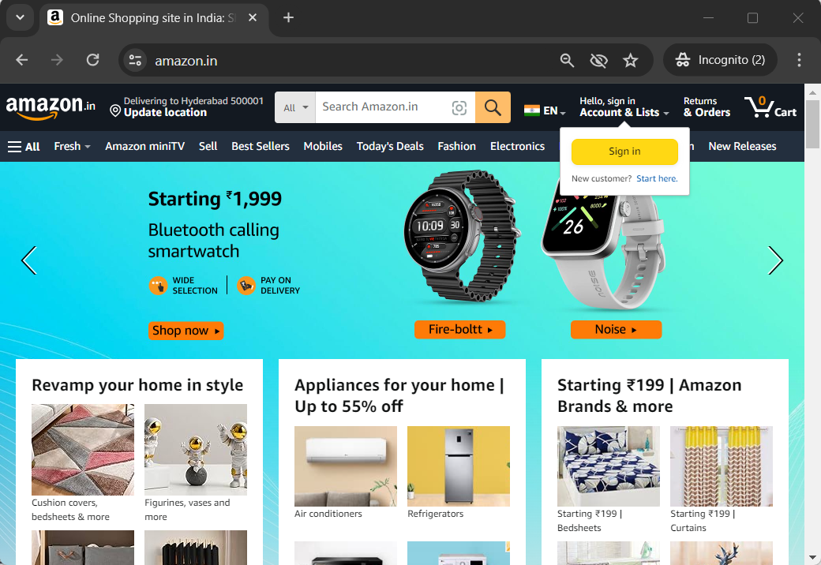
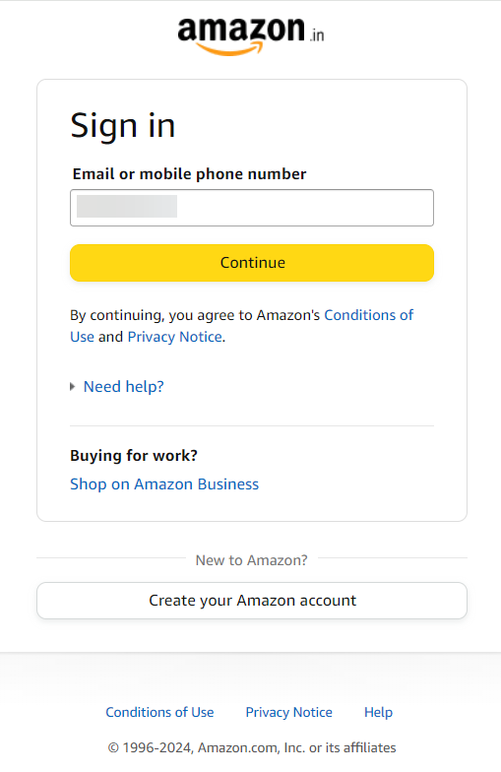
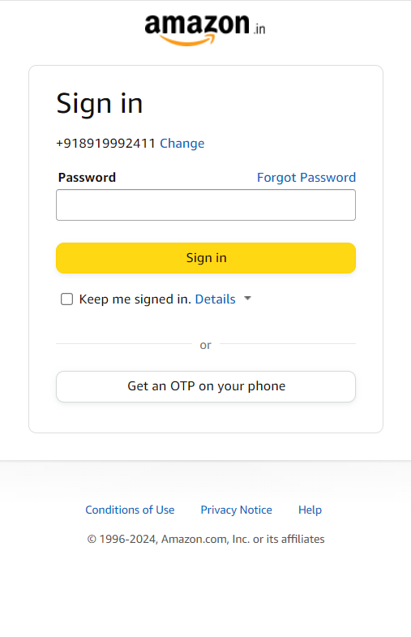
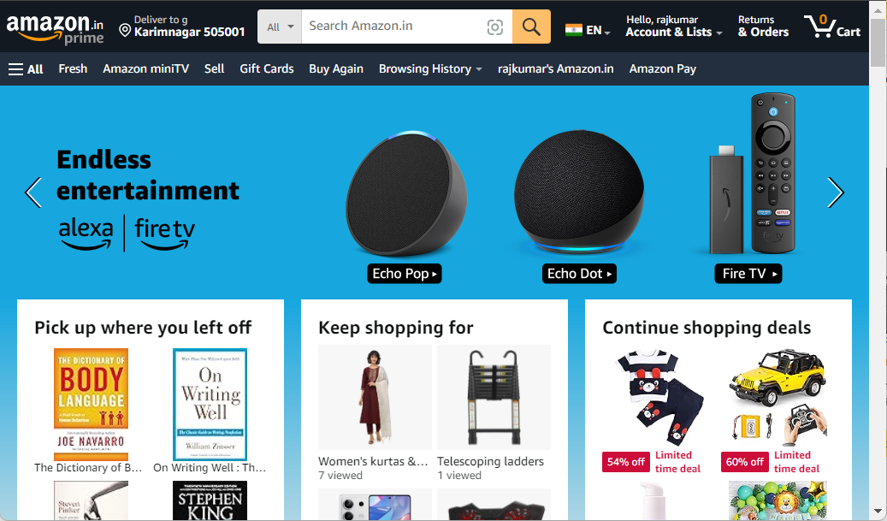
Login to Amazon.in
1
Open your desired browser and navigate to Amazon.in
1
2
2
Click Sign in button
3
Enter your credentials: Email or mobile phone number > Continue > Password > Sign in
3

Slide 5
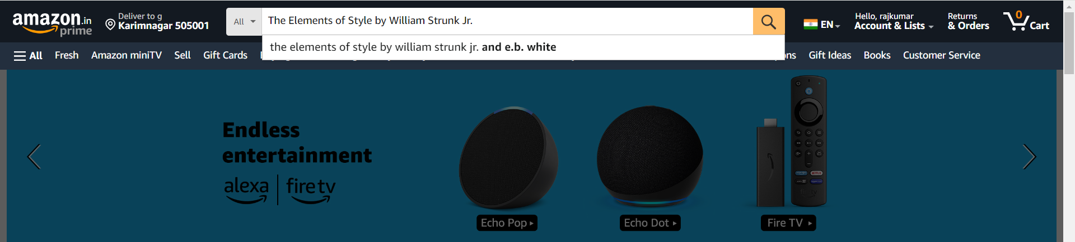

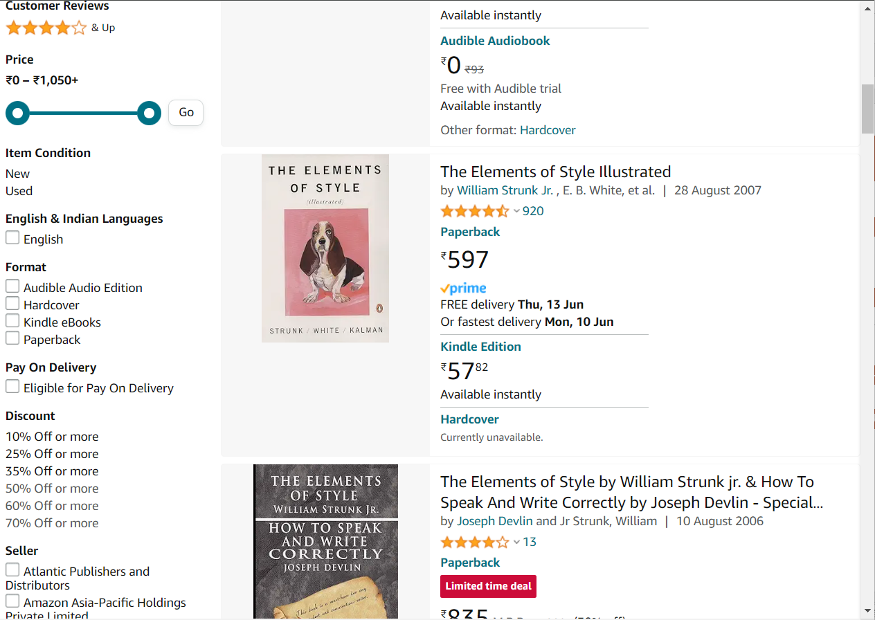
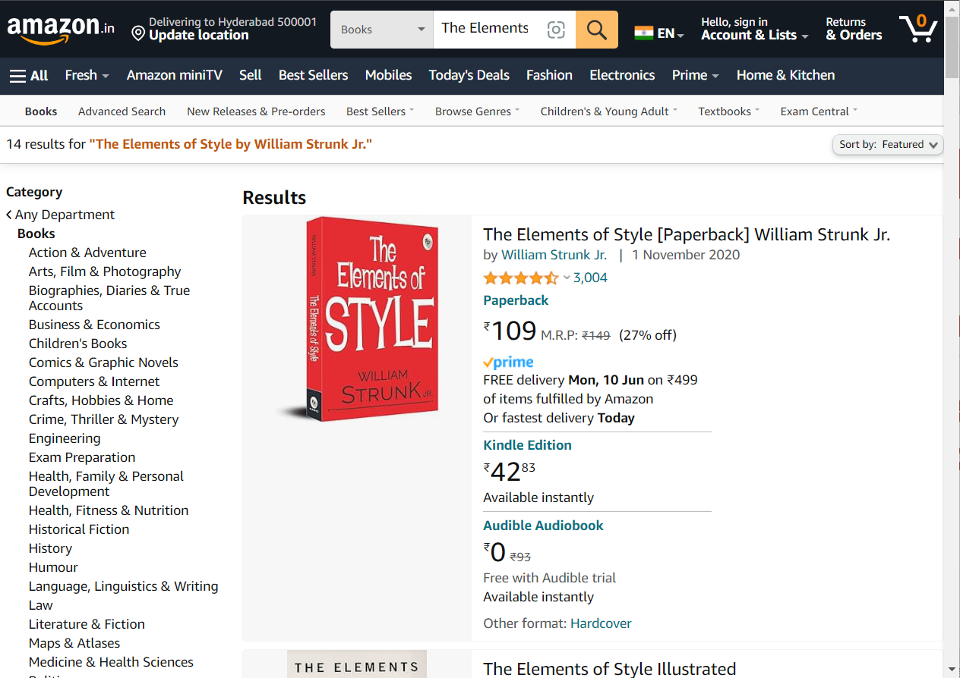
Search for The Elements of Style by William Strunk Jr. Book and Apply Filter
4
4
In the Search bar, type The Elements of Style by William Strunk Jr. and click icon
5
On the left-hand side of the search results page, navigate to Format section and select Paperback checkbox
6
Navigate to Pay On Delivery section, select Eligible for Pay On Delivery checkbox
5
6

Slide 6
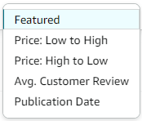
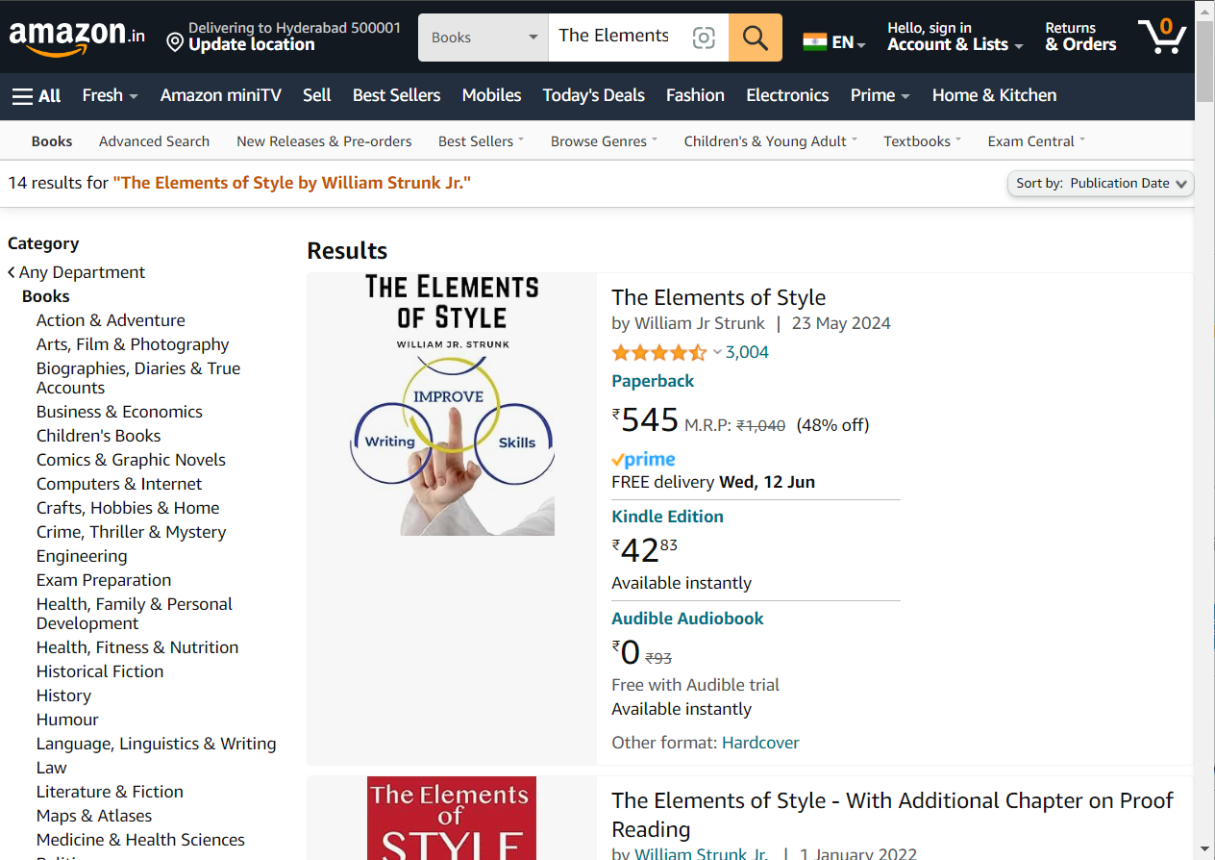
Add The Elements of Style by William Strunk Jr. Book to Amazon Shopping Cart
7
On the top-right, click on Sort by dropdown
7
8
Select Publication Date
8

Slide 7
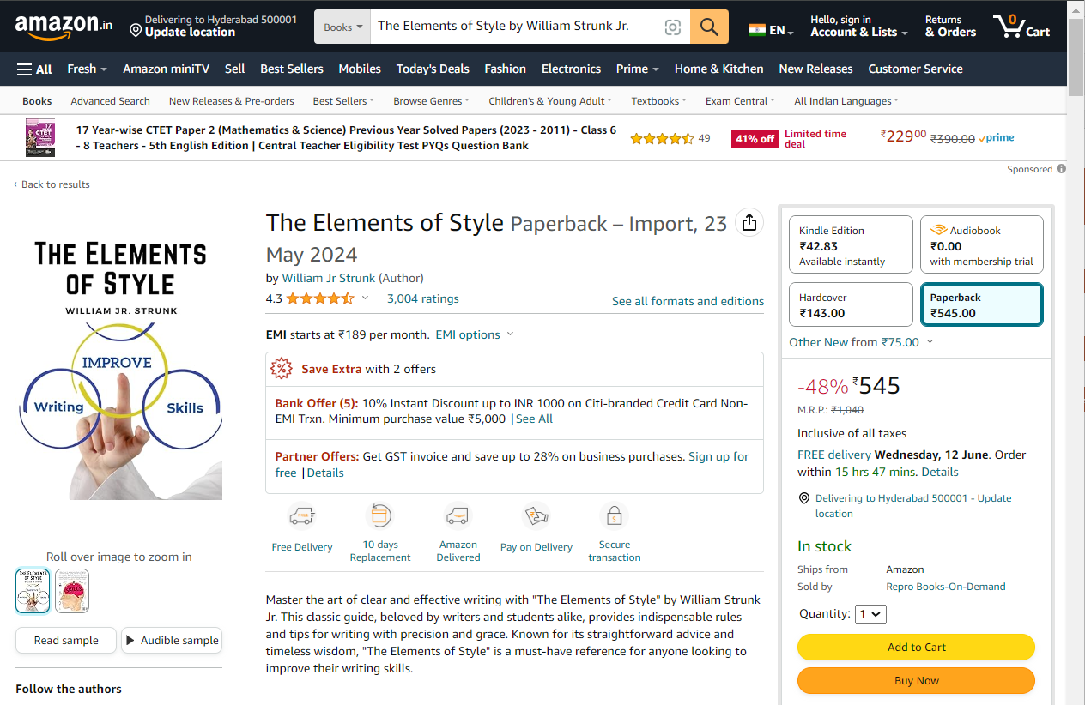
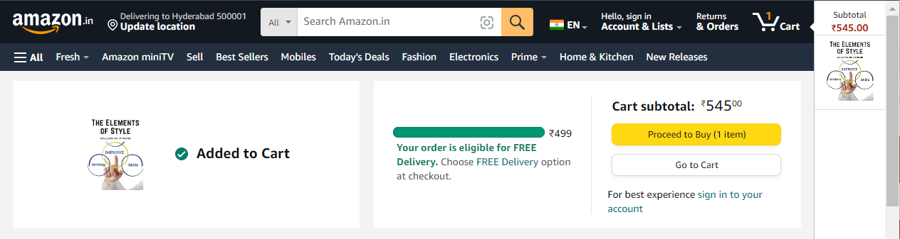
Add The Elements of Style by William Strunk Jr. Book to Amazon Shopping Cart
9
Open the desired book
9
10
Click on Add to Cart button
By following these steps, you can locate and add the latest publication of The Elements of Style by William Strunk Jr. to your Amazon shopping cart
10

Slide 8
Revision History
# | Last Revised Date | Description | Rationale | Version
1 | 8 June 2024 | Initial draft | Initial draft | 0.1

Slide 9
Thank You!
Thank you for viewing the instructions

